Slide 1
Milestone #4:
Moving to Experiment Data
Estee Lauder 1B

Slide 2
Univariate Exploration
01
(Distribution of each variable)

Slide 3
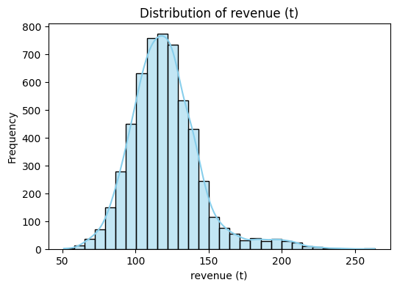
Histogram - revenue (t)
This histogram of distribution of revenue appears to be normally distributed with a slight right skew. This shows that most customers contribute a similar level of revenue while, a few outliers show that a few customers spend more than average.

Slide 4
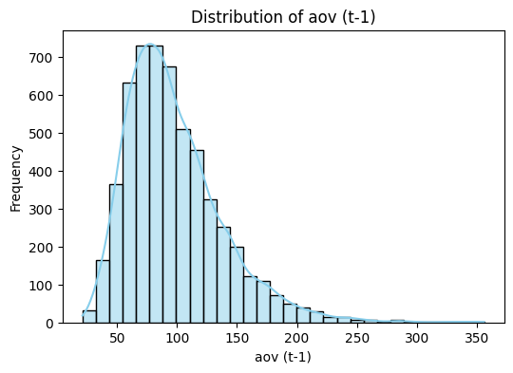
Histogram - aov(t-1)
This histogram of distribution of average order value is right-skewed. This means that the majority of costumes spend similar, moderate amounts per order, while a few customers spend a higher number extending the right of the histogram.

Slide 5
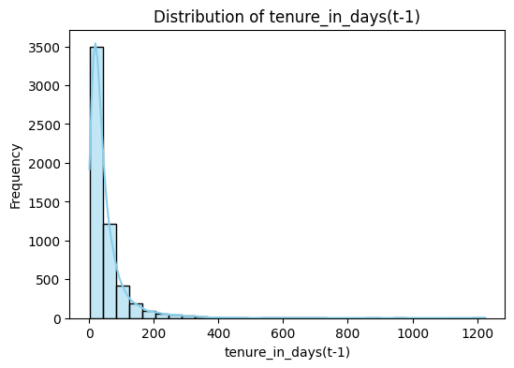
Histogram - tenure in days(t-1)
This histogram of distribution of tenure in days shows a strong right skew showing customers have short tenures so they are new, (less than 100 days), while a few have a longer period (been with the company longer).

Slide 6
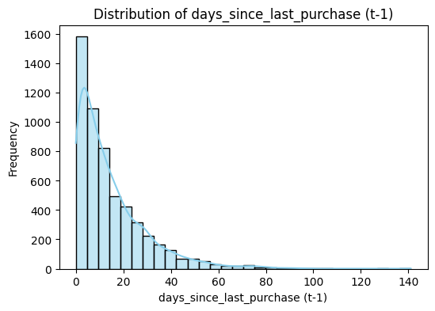
Histogram - days since last purchase (t-1)
This histogram of distribution of days since last purchase is right-skewed, the data points are to the left side of the graph with a tail extended to the right. The graph is showing a large group of active customers who made recent purchases and a few customers who haven’t made purchases in a long time on the tail.

Slide 7
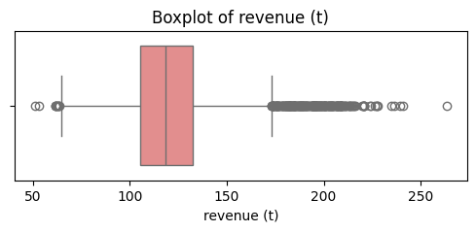
Boxplot - revenue (t)
This distribution of revenue box plot shows the data is right-skewed with a median around 120. The IQR suggests that most revenue values fall between 100 to 135. The outliers are on the low end ($50-60), and large amount of outliers on the high end 200+. This shows customers behaviors, the regular everyday purchases, and the less frequent but large sales.

Slide 8
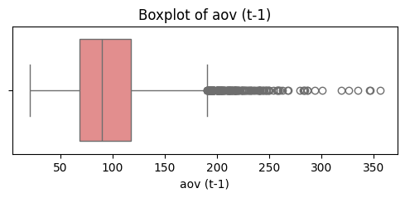
Boxplot - aov (t-1)
This plot shows the data is right skewed, The median is about $95, the IQR falls between 75-110, meaning 50% of aov falls between that range. There are many outliers on the right $200+, which represent transaction of aov being higher than the norm. Overall this graph shows an average range of $75-110, and transactions with a higher average value are transactions of more expensive products.

Slide 9
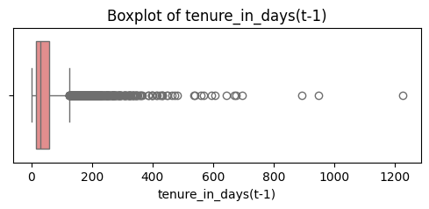
Boxplot - tenure in days (t-1)
This boxplot shows the data is right skewed and the median is low, so 50% of the tenures are shorter than around 50 days while 50% are longer. The IQR shows that 50% of the tenures fall between roughly 25-100 days. There appears to be some outliers going beyond 600 days. Overall this plot shows customers have a short tenure but a small number have long tenure.

Slide 10
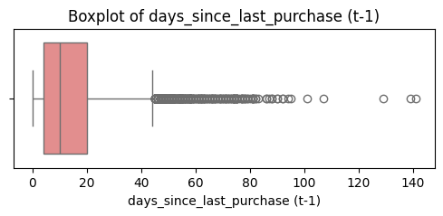
Boxplot - days since last purchase (t-1)
This boxplot show days since last purchase. The data is right skewed showing that customers made a recent purchase while others haven’t purchased in a while. The median is around 15 days so half the customers made their last purchase within the past 15 days. The IQR spans from 3 to about 35 days so 50% of customers made their purchase around that time.
There are many outliers beyond 45 days some beyond 100, which represent customers who haven’t purchased in a while.

Slide 11
comparisons
02
Control vs. Treatment

Slide 12
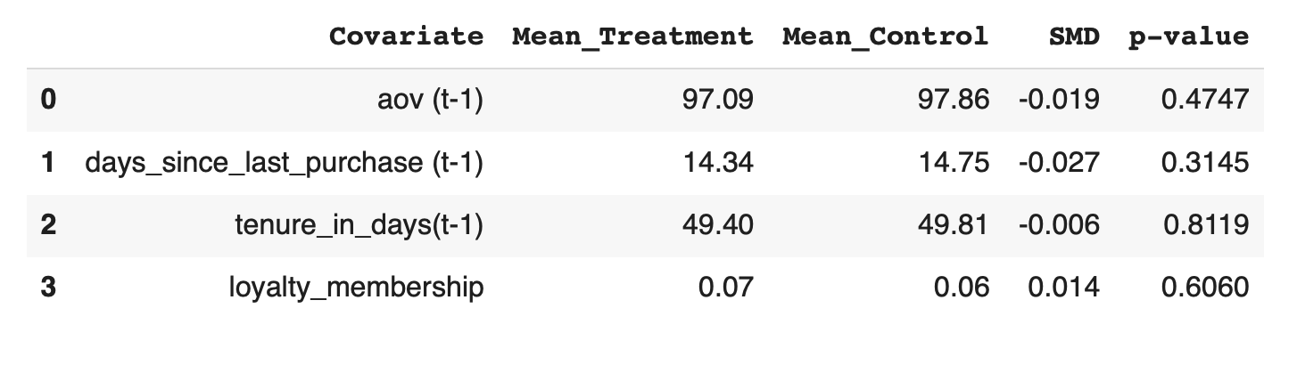
Compare distributions of revenue (t) between groups
Goal: To confirm the experiment was fair by ensuring the treatment and control groups were statistically similar beforehand.
Evidence 1: Standardized Mean Difference (SMD)
All SMD values are near zero (well below the 0.1 industry standard), indicating excellent balance.
Evidence 2: p-values
All p-values are high, confirming there were no significant pre-existing differences between the groups.
Conclusion: The randomization was successful. We have a reliable foundation to trust that our results are due to the gift strategy itself.

Slide 13
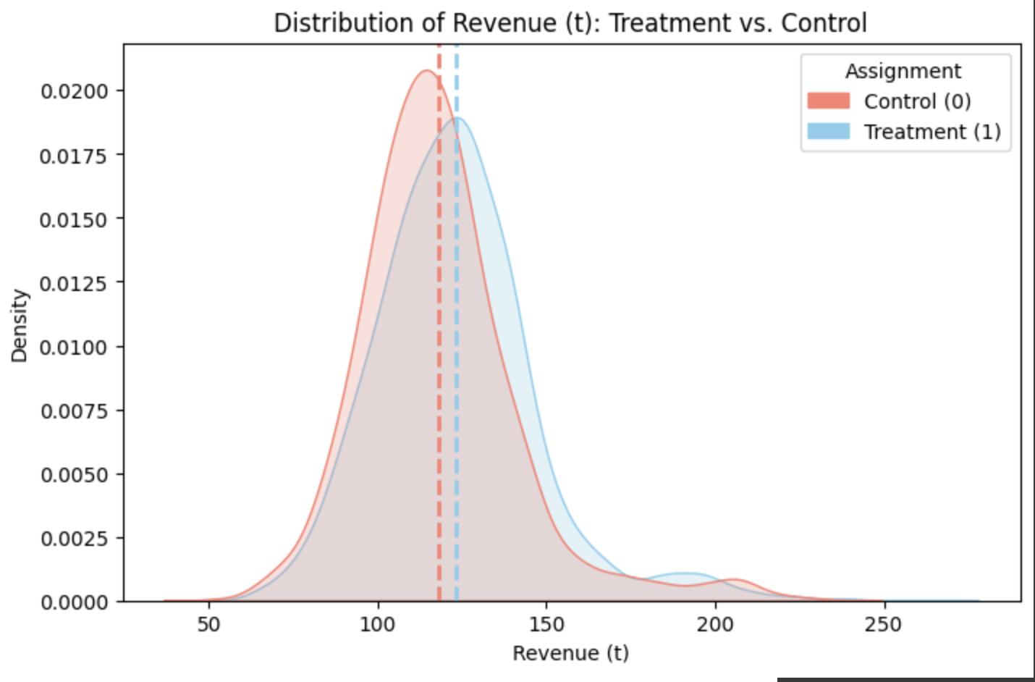
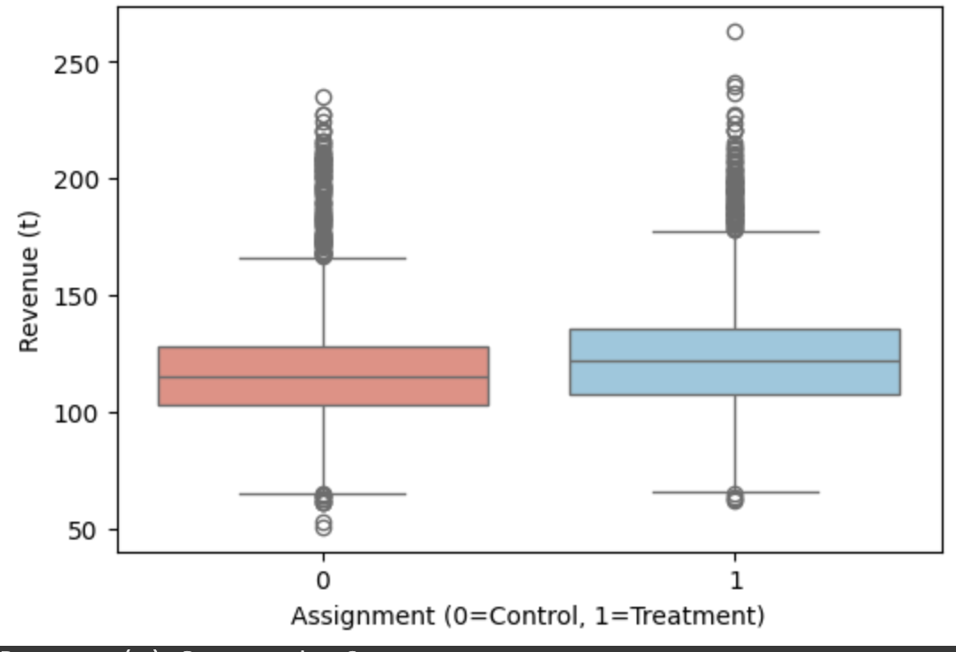
Revenue Distributions (Control vs. Treatment)
Primary Observation: A qualitative comparison of the revenue distributions reveals a separation between the treatment and control groups, although there is considerable overlap.
Evidence from Density Plot:
The density plot for the treatment group (sky blue) exhibits a slight but observable rightward shift relative to the control group (salmon). The average revenue for the treatment group is higher than the control group.
Evidence from Box Plot:
This directional difference is quantified in the box plot, which indicates an elevated median revenue for the treatment group.
Preliminary Conclusion:
The exploratory evidence is inconsistent with a null hypothesis of no effect. Formal statistical testing is required to determine the significance of this observed difference.

Slide 14
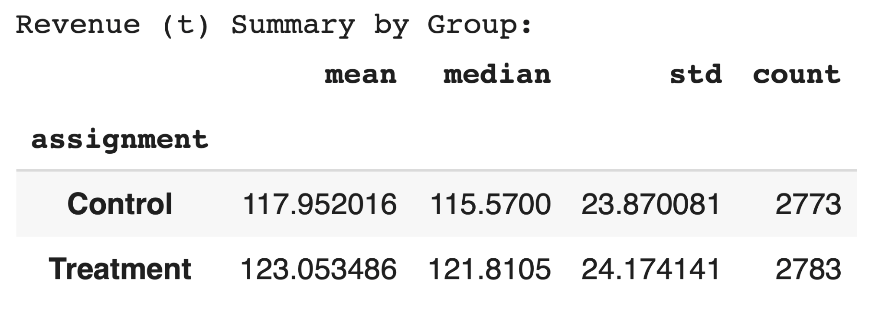
The group summary table shows:
Objective: To quantitatively summarize the directional difference observed in the visual analysis of the revenue distributions.
Key Metrics: The treatment group exhibits a higher mean revenue (+$5.10) and a higher median revenue (+$6.24) compared to the control.
Variance: The standard deviations of the two groups are comparable, suggesting the intervention did not substantially increase revenue volatility.
Implication: These descriptive statistics provide quantitative support for the visual evidence. The next step is to assess the statistical significance of this observed difference.

Slide 15
Explore relationships
03
Goal: See correlations & treatment heterogeneity patterns

Slide 16
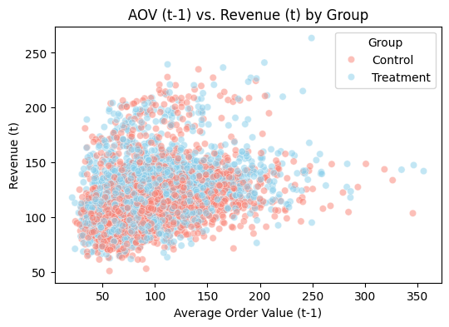
Scatterplot – AOV (t-1) vs. Revenue (t) by Assignment
Question: Did the treatment work better on customers who spend more per order?
Analysis: We plotted each customer's pre-experiment Average Order Value (AOV) against their post-experiment revenue.
Finding: The treatment group (blue) is consistently and slightly higher than the control group (salmon) across all AOV levels.
Conclusion: The modest revenue lift was broad-based and not driven by a specific spending segment like high-value customers.

Slide 17
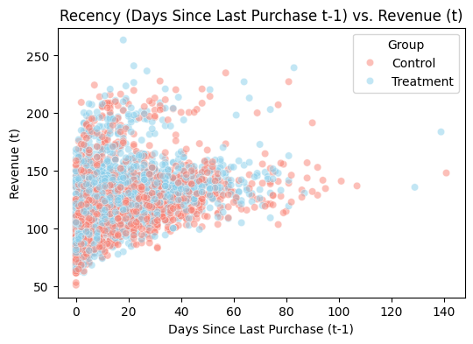
Scatterplot – Days Since Last Purchase (t-1) vs. Revenue (t)
Question: Was the treatment more effective on our recent, most active customers?
Analysis: We plotted the days since a customer's last purchase (Recency) against their post-experiment revenue.
Finding: The treatment group again shows a consistent, modest lift over the control group, regardless of how recently a customer made a purchase.
Conclusion: The treatment's small, positive effect is also consistent across different levels of customer engagement.

Slide 18
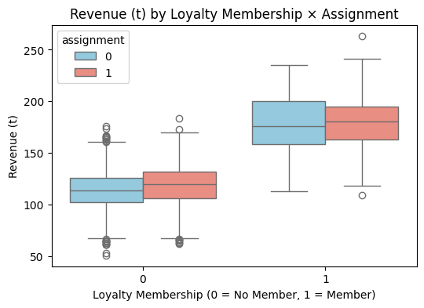
Boxplot – Revenue by Loyalty Membership × Assignment
Loyalty members (1) show much higher median revenue than non-members (0) across both groups.
The treatment group’s box is slightly higher within each loyalty category, especially for members, hinting at a modest uplift among loyal customers.
Interpretation summary:
Loyalty membership strongly predicts higher revenue overall. The treatment effect appears somewhat stronger among loyalty members, suggesting possible heterogeneous treatment impact.

Slide 19
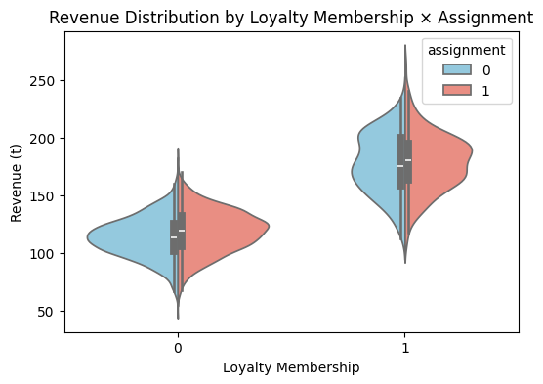
Violin Plot – Revenue Distribution by Loyalty × Assignment
The wider, higher violins for loyalty = 1 confirm greater spending variation among members.
The treatment violin (salmon) for members skews slightly upward relative to control (blue), reinforcing the idea of a small positive effect in that subgroup.
Non-members show overlapping distributions, implying little or no effect there.
Interpretation summary: Treatment shows a slightly higher and broader revenue distribution among loyalty members but minimal change among non-members — indicating treatment heterogeneity by loyalty status.

Slide 20
Overall Takeaway
Across relationships, revenue aligns positively with prior AOV and negatively with recency. Treatment effects are subtle overall but may be somewhat stronger for loyal, high-spending customers.

Slide 21
Analyze & Understand
04
Skews & Outliers

Slide 22
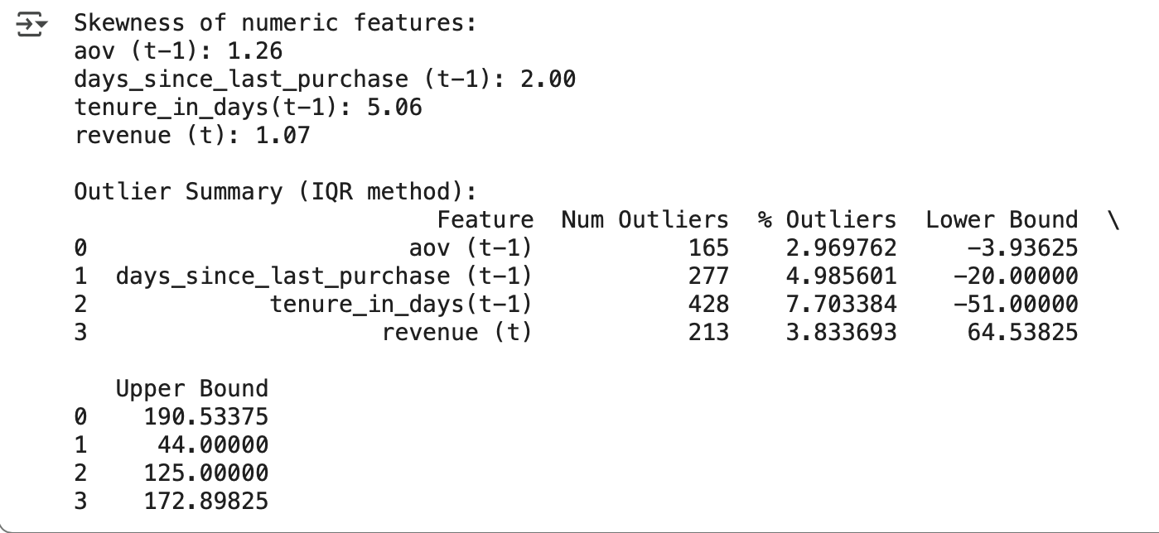
The distributions are not symmetric and around 3 - 8% of rows per feature have outliers

Slide 23
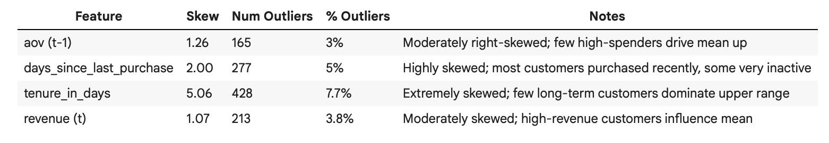
Interpretation Summary:
The numeric features in the experiment dataset show right-skewed distributions, indicating that most customers cluster at lower values while a few high-value customers form a long tail.
Specifically, tenure_in_days is extremely skewed (5.06), reflecting a small number of very long-term customers, while days_since_last_purchase is highly skewed (2.00), showing that most customers purchased recently but some had long gaps. aov (t-1) (1.26) and revenue (t) (1.07) are moderately skewed, suggesting a few high spenders drive up average values.
Outlier analysis using the IQR method shows that outliers are mostly on the high end, including customers with exceptionally high spending, long tenure, or infrequent purchases.
These points represent real customer behavior and are important for modeling, though they should be monitored as they may influence variance and effect estimates.

Slide 24
Interpretation Notes:
Right-skewed distributions are common in customer datasets. Outliers mostly reflect high-value or long-tenure customers, not data errors.
These outliers should generally be kept for modeling but monitored for impact on variance or treatment effect estimates. Also based off the previous diagrams above.

Slide 25
Thank you!
Notebook Link

